Slide 1


Multi-omics infrastructure and data for R/Bioconductor
Levi Waldron
June 21, 2017
Notes:
Hi. I’d like to introduce you to MultiAssayExperiment, a framework for the representation and analysis of multi-omics experiments in Bioconductor.

Slide 2
Who are we?
Part of Bioconductor technical advisory board
me
Two software developers, one also with the Bioconductor core team
Marcel Ramos, Lucas Schiffer
A post-doc, MPH students, interns
aspiring data scientists or epidemiologists
Andy Samedy, Audrey Renson, Carmen Rodriguez

Slide 3
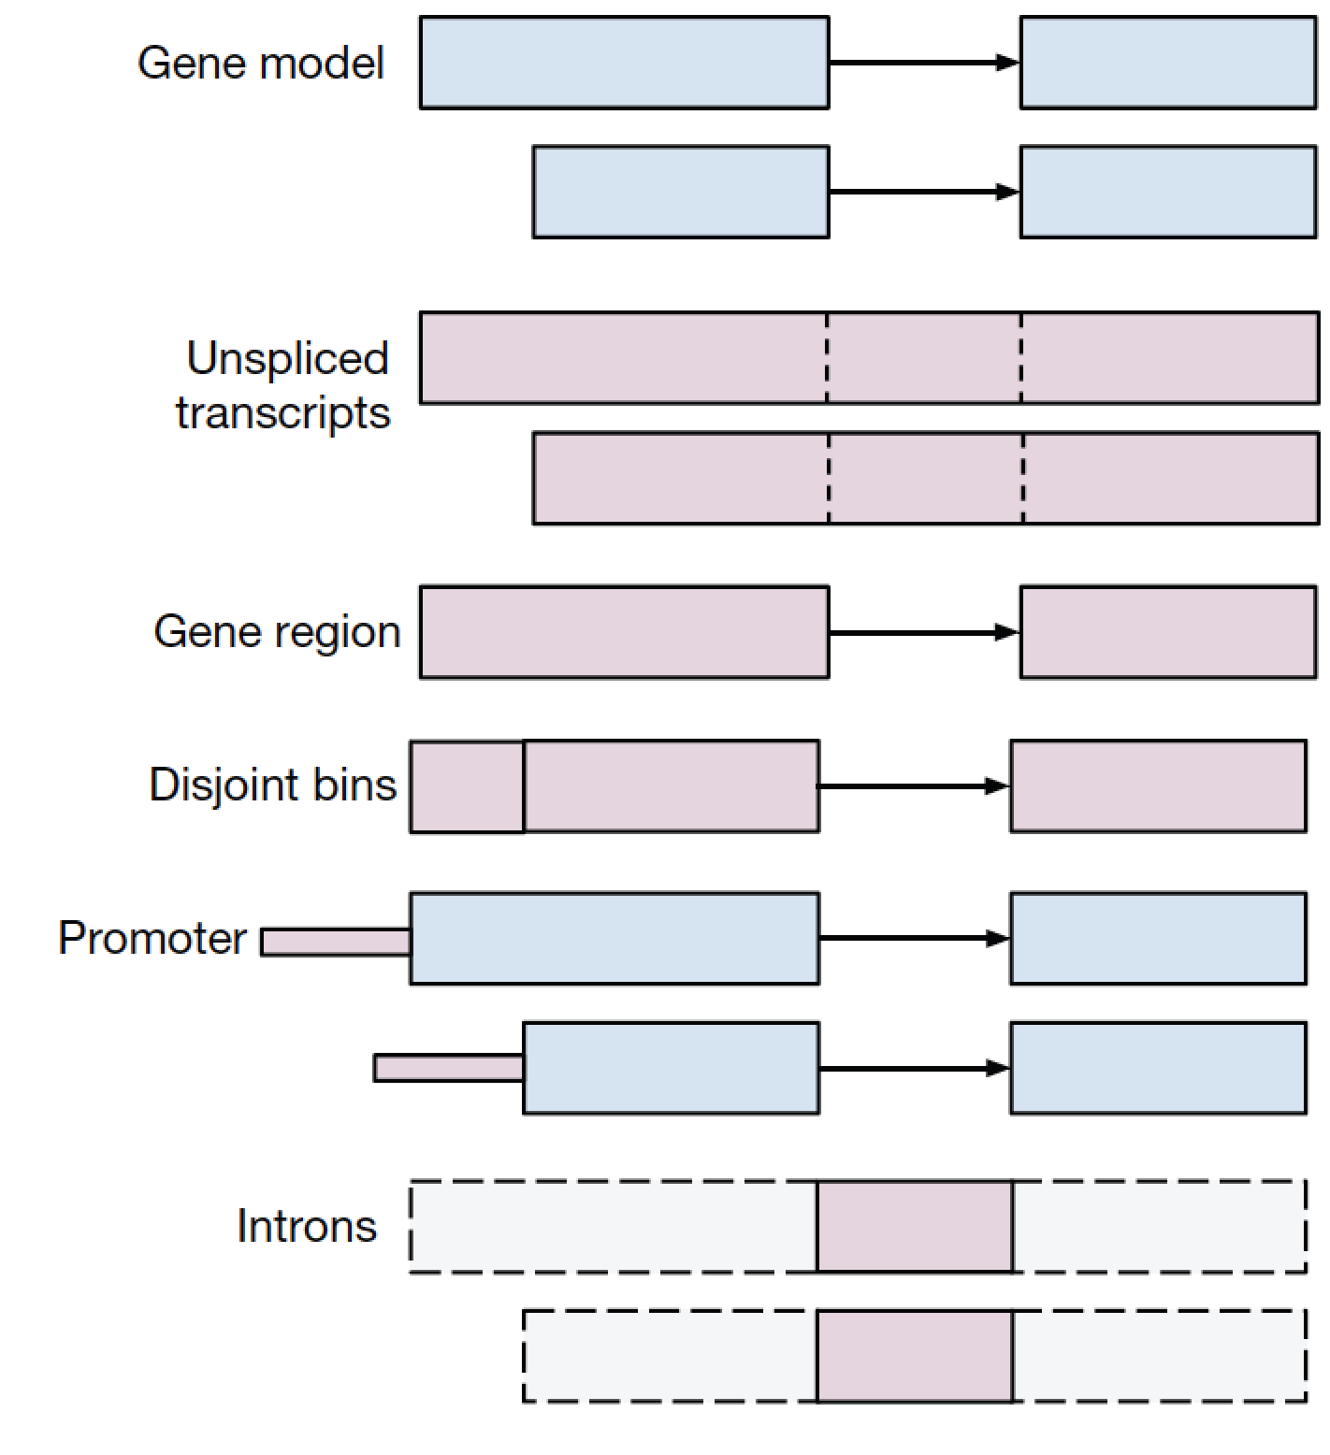
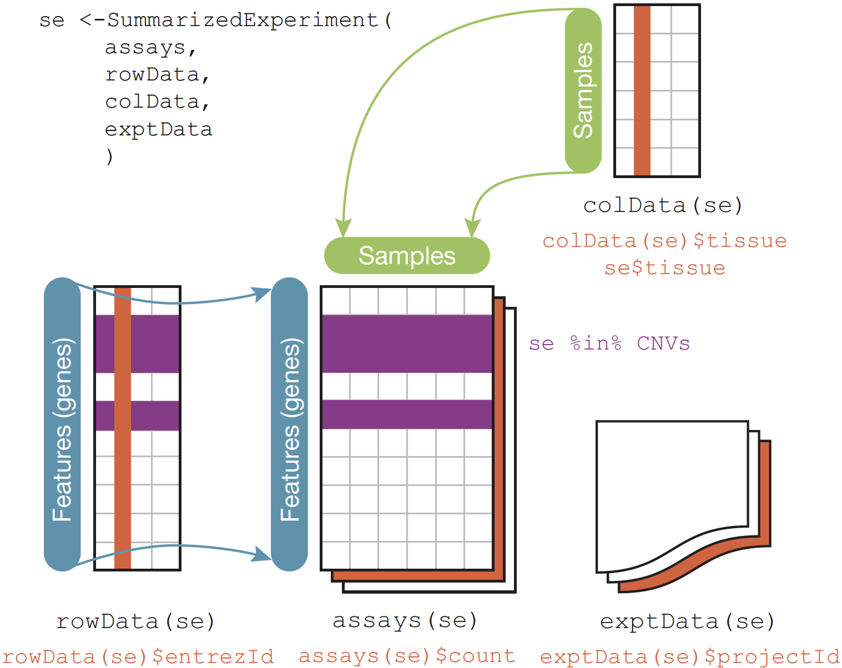
Why Bioconductor?
1,400 packages on a backbone of data structures
The Genomic Ranges algebra
The integrative data container SummarizedExperiment
Huber, W. et al. Orchestrating high-throughput genomic analysis with Bioconductor. Nat. Methods 12, 115–121 (2015).
Notes:
For anyone unfamiliar with Bioconductor, it is a suite of over a thousand packages for statistical analysis and visualization of high-throughput biological data, accessible via the R programming language and unified by a backbone of core data structures designed for the requirements of specific genomic data types.
* Core developers provide this key set of data structures that are efficient and well tested, and contributed packages are expected to use these where applicable
For example, the Genomic Ranges system provides a representation and algebra for any data associated with genomic coordinates. Efficient in-memory and on-disk representations
Integrative data containers such as SummarizedExperiment, integrate high-throughput data with, for example, gene annotations, sample data such as clinical information, experimental metadata, and can even represent multiple assays. In this case, however, the assays must be matrix-like and of identical dimensions
Until now, Bioconductor was lacking in a core data structure to provide a framework for analysis and development of tools for multi-omics experiments

Slide 4
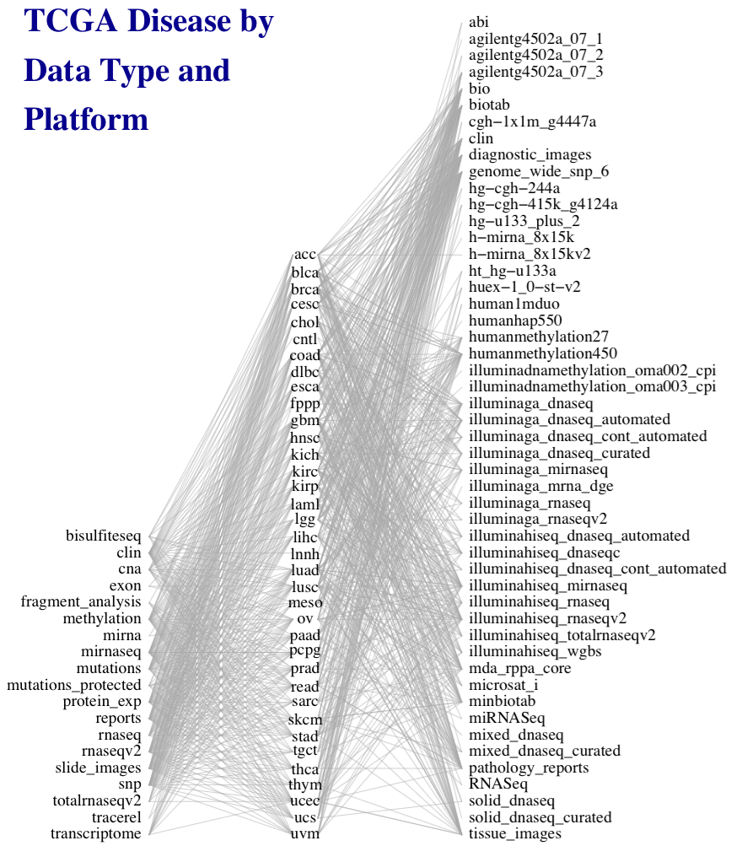
Multi-assay experiments can be complex
50 platforms
Diseases, platforms, and data types of
The TCGA
33 diseases
19 data types
Credit: Marcel Ramos
Notes:
This work was motivated by the need to simplify general statistical analysis and development of bioinformatic tools for a study as complex as the Cancer Genome Atlas, where 33 cancers were assayed on many platforms to generate different types of data, but also to provide a simplified framework for more easily reproducible and less error-prone analysis of simpler experiments involving just a couple of complementary assays and clinical data.

Slide 5
The need for MultiAssayExperiment
Need a core data structure to:
harmonize single-assay data structures
relate multiple assays & clinical data
handle missing and replicate observations
accommodate ID-based and range-based data
support on-disk representations of big data
Ramos et al. bioRxiv 144774
Notes:
A core data structure was needed to
* harmonize existing structures for different types of data,
* relate assays with each other and clinical data
* handle the reality that such experiments are often incomplete and missing observations on some assays, and also may contain replicates, time series, or matched normal,
* accommodate data that are indexed by IDs such as genes and data indexed by genomic ranges,
* and support on-disk representations for big data

Slide 6
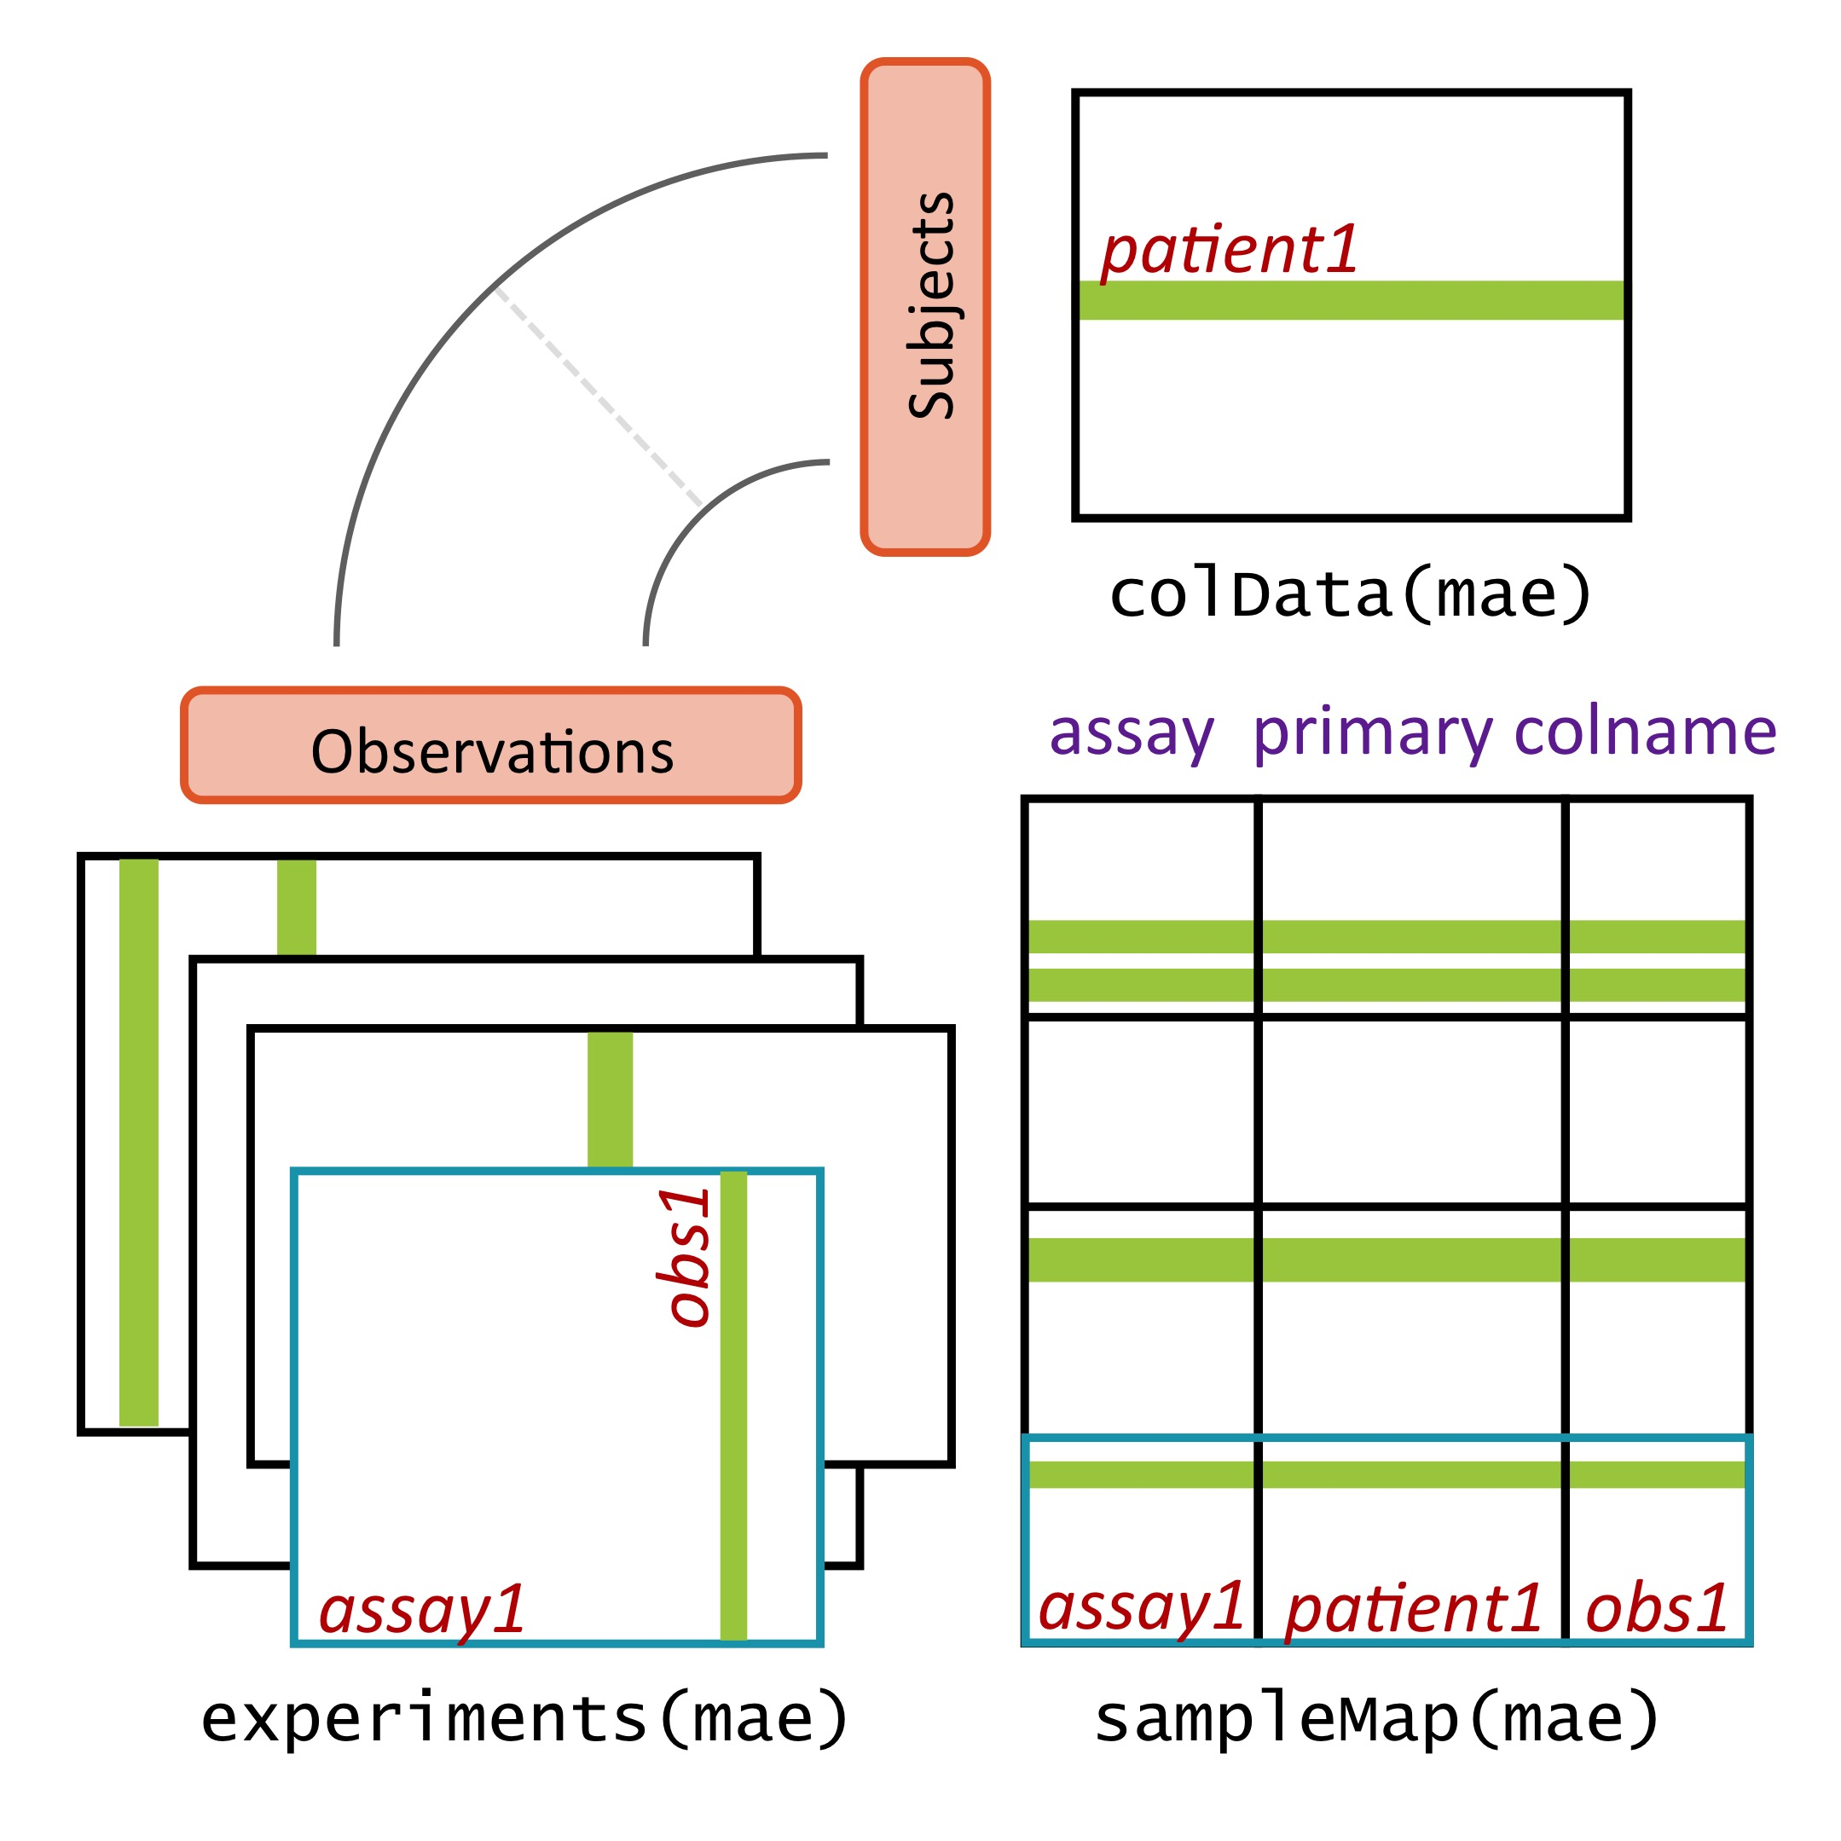
MultiAssayExperiment design
Credit: Marcel Ramos
Ramos et al. bioRxiv 144774
Notes:
MultiAssayExperiment addresses these challenges by relating a table of information about subjects, say clinical and pathological data, to a series of genomic data sets of arbitrary shape and even non-tabular data, via a map or a network relating these. This sounds complex and it can be, but from the analyst’s perspective, there is an API that will be familiar to users of R, and that abstracts this complexity from the user. Constructing, accessing, subsetting, data management or manipulation, and combining and reshaping into forms usable by standard tools become straightforward.

Slide 7
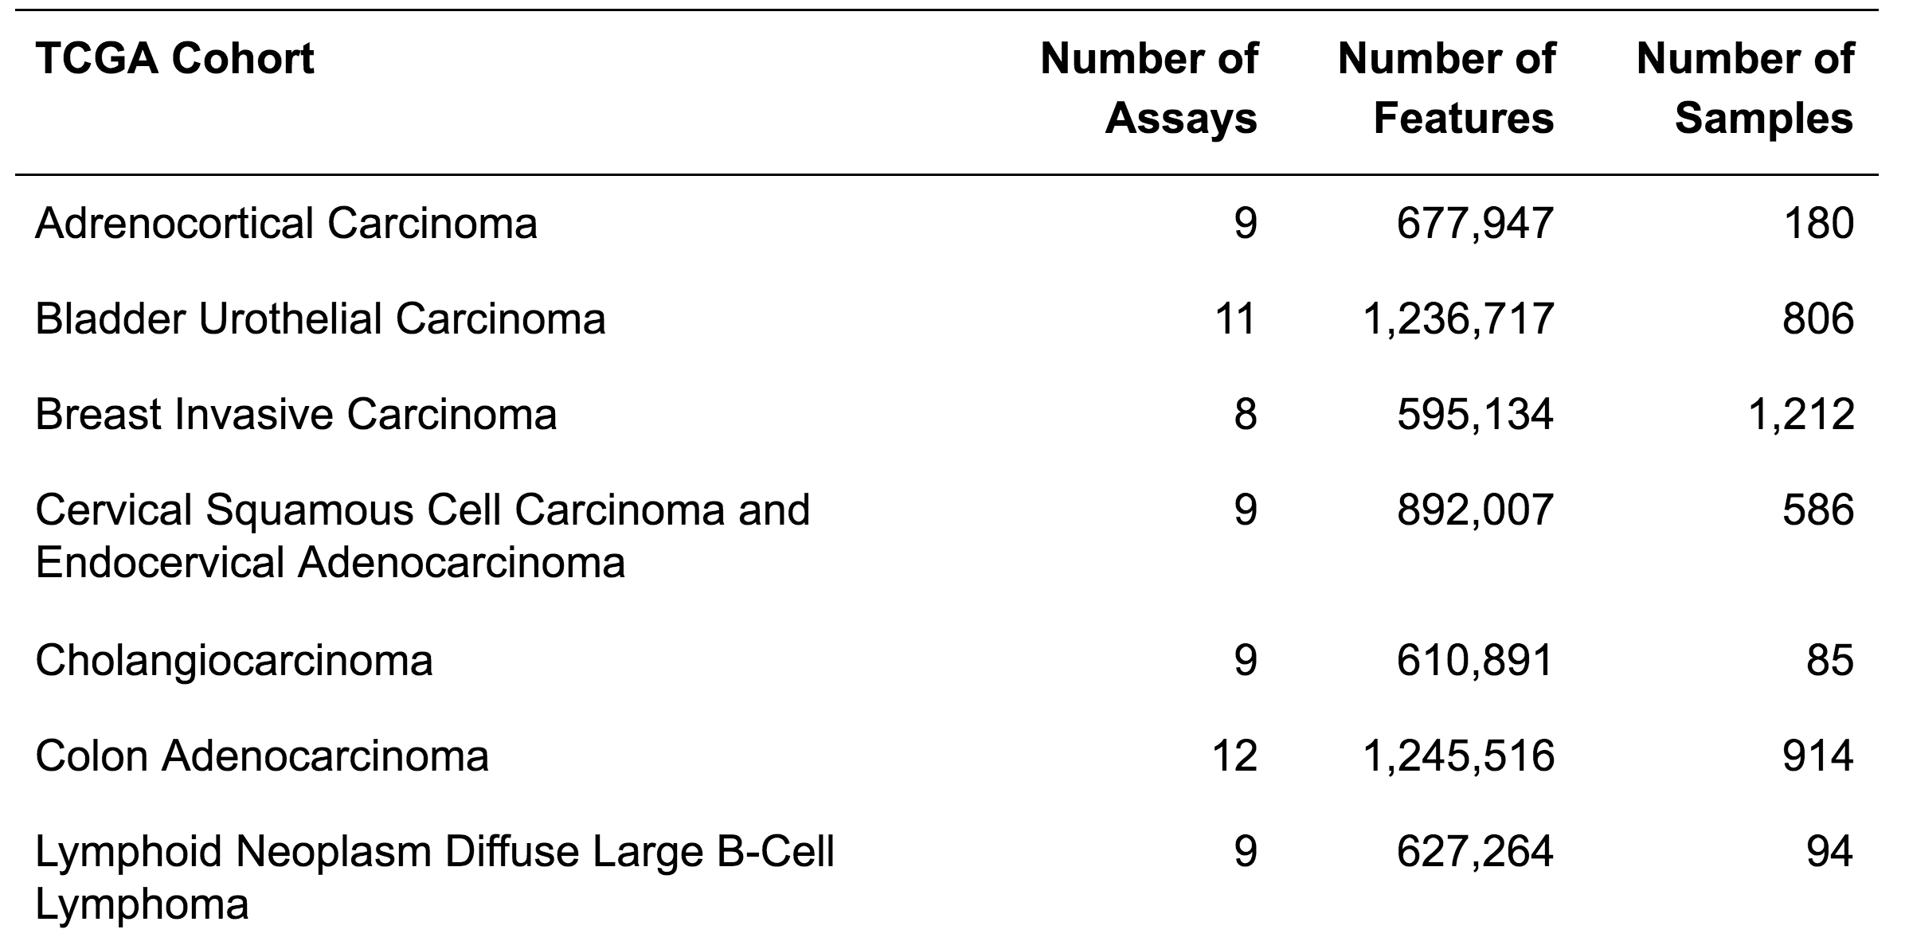
TCGA as MultiAssayExperiments
…... 33 cancer types
Access from www.github.com/waldronlab/MultiAssayExperiment

Slide 8
TCGA as MultiAssayExperiments
> acc
A MultiAssayExperiment object of 9 listed
experiments with user-defined names and respective classes.
Containing an ExperimentList class object of length 9:
[1] RNASeq2GeneNorm: ExpressionSet with 20501 rows and 79 columns
[2] miRNASeqGene: ExpressionSet with 1046 rows and 80 columns
[3] CNASNP: RaggedExperiment with 79861 rows and 180 columns
[4] CNVSNP: RaggedExperiment with 21052 rows and 180 columns
[5] Methylation: SummarizedExperiment with 485577 rows and 80 columns
[6] RPPAArray: ExpressionSet with 192 rows and 46 columns
[7] Mutations: RaggedExperiment with 20166 rows and 90 columns
[8] gistica: SummarizedExperiment with 24776 rows and 90 columns
[9] gistict: SummarizedExperiment with 24776 rows and 90 columns
Features:
experiments() - obtain the ExperimentList instance
colData() - the primary/phenotype DataFrame
sampleMap() - the sample availability DataFrame
`$`, `[`, `[[` - extract colData columns, subset, or experiment
*Format() - convert into a long or wide DataFrame
assays() - convert ExperimentList to a SimpleList of matrices
>

Slide 9
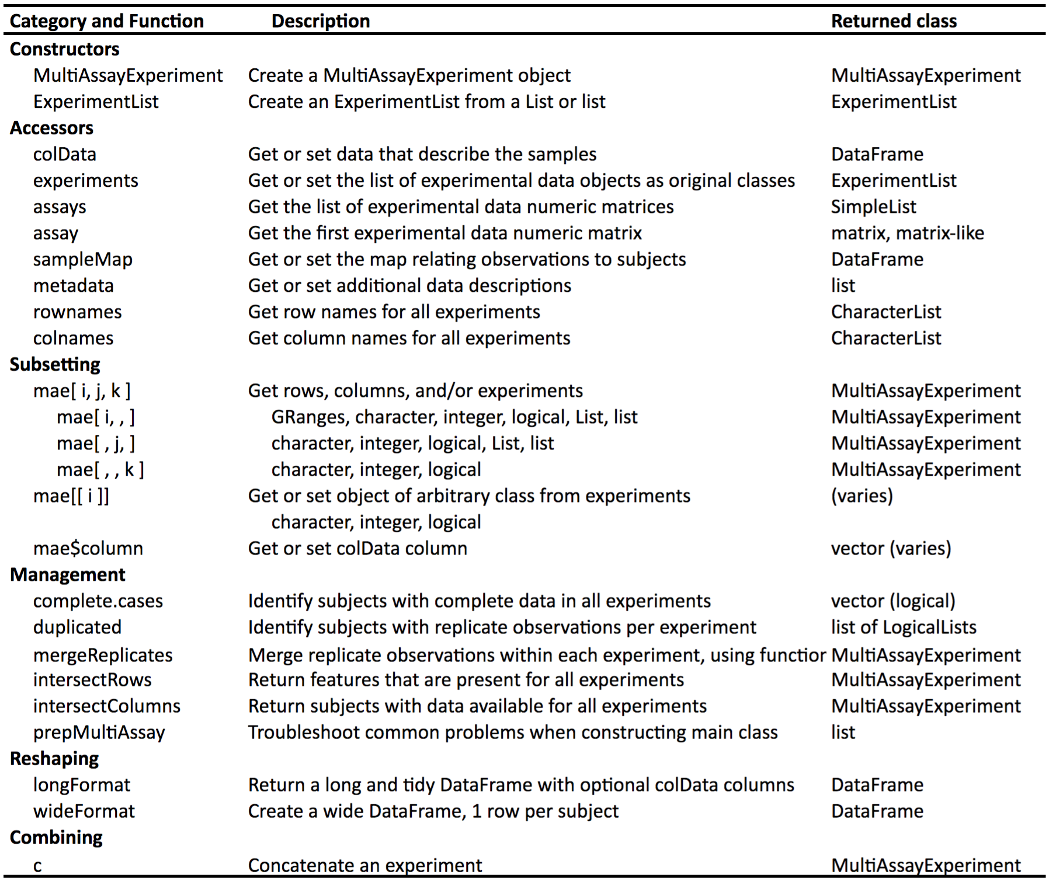
The MultiAssayExperiment API
Credit:
Marcel Ramos
Ramos et al. bioRxiv 144774
Notes:
To help those wanting to analyze TCGA data, we’ve constructed MultiAssayExperiments for 33 cancer types. Each cancer type is represented by a single object containing all the most commonly used, unrestricted data. These objects are immediately usable, even on most laptops, with the API shown on the previous page.

Slide 10
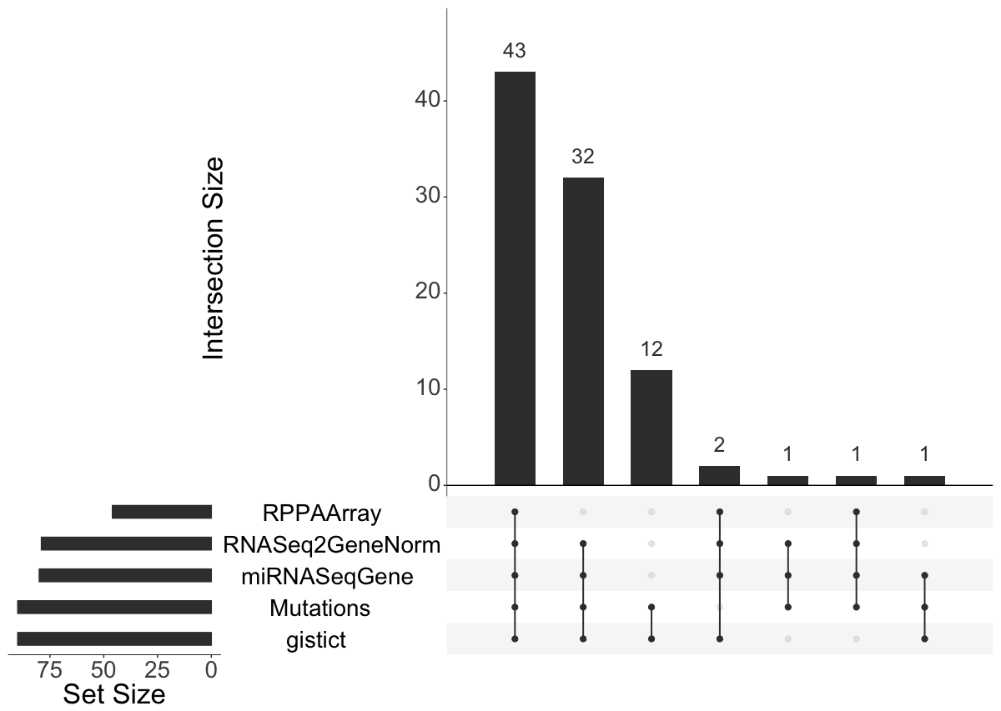
For building visualizations
Upset Venn diagram for adrenocortical carcinoma TCGA
> data(miniACC)
> upsetSamples(miniACC)
Ramos et al. bioRxiv 144774
Notes:
To give you an idea of what this looks like, here is a sort of complex Venn Diagram of just four of the assays for GBM. Although GISTIC copy number and microRNA are assayed on about 600 samples each, but only a fraction of these cases have data available for both, and an even smaller fraction have data for all four of GISTIC, microRNA, methylation, and RNA-seq data.

Slide 11
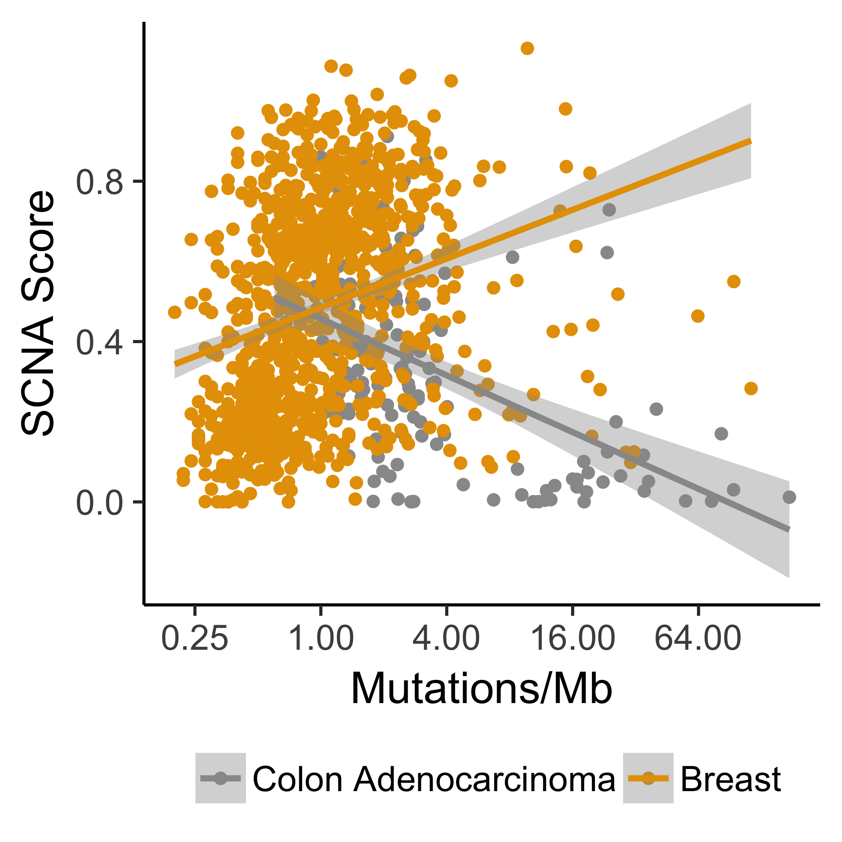
For multi-omics analysis
Davoli et al. Tumor aneuploidy correlates with markers of immune evasion and
with reduced response to immunotherapy. Science 355, (2017).
> mae <- mae[, , c("Mutations", "gistict")]
> mae <- intersectColumns(mae)
> mae$cnload <- colMeans(abs(assay(mae[["gistict"]])))
Ramos et al. bioRxiv 144774
Notes:
Analyses of a single assay or that combine assays, such as this reproduction of the result from Davoli et al. that cancer types with high levels of aneuploidy often show a positive correlation of mutation load and chromosomal instability, perhaps due to a higher tolerance of deleterious mutations, as shown here in orange for breast cancer. Whereas, tumors with a hypermutator phenotype rarely display extensive chromosomal instability, resulting in a negative correlation of mutation load and chromosomal instability in cancer types where hypermutation is common (shown in grey for colon adenocarcinoma).

Slide 12
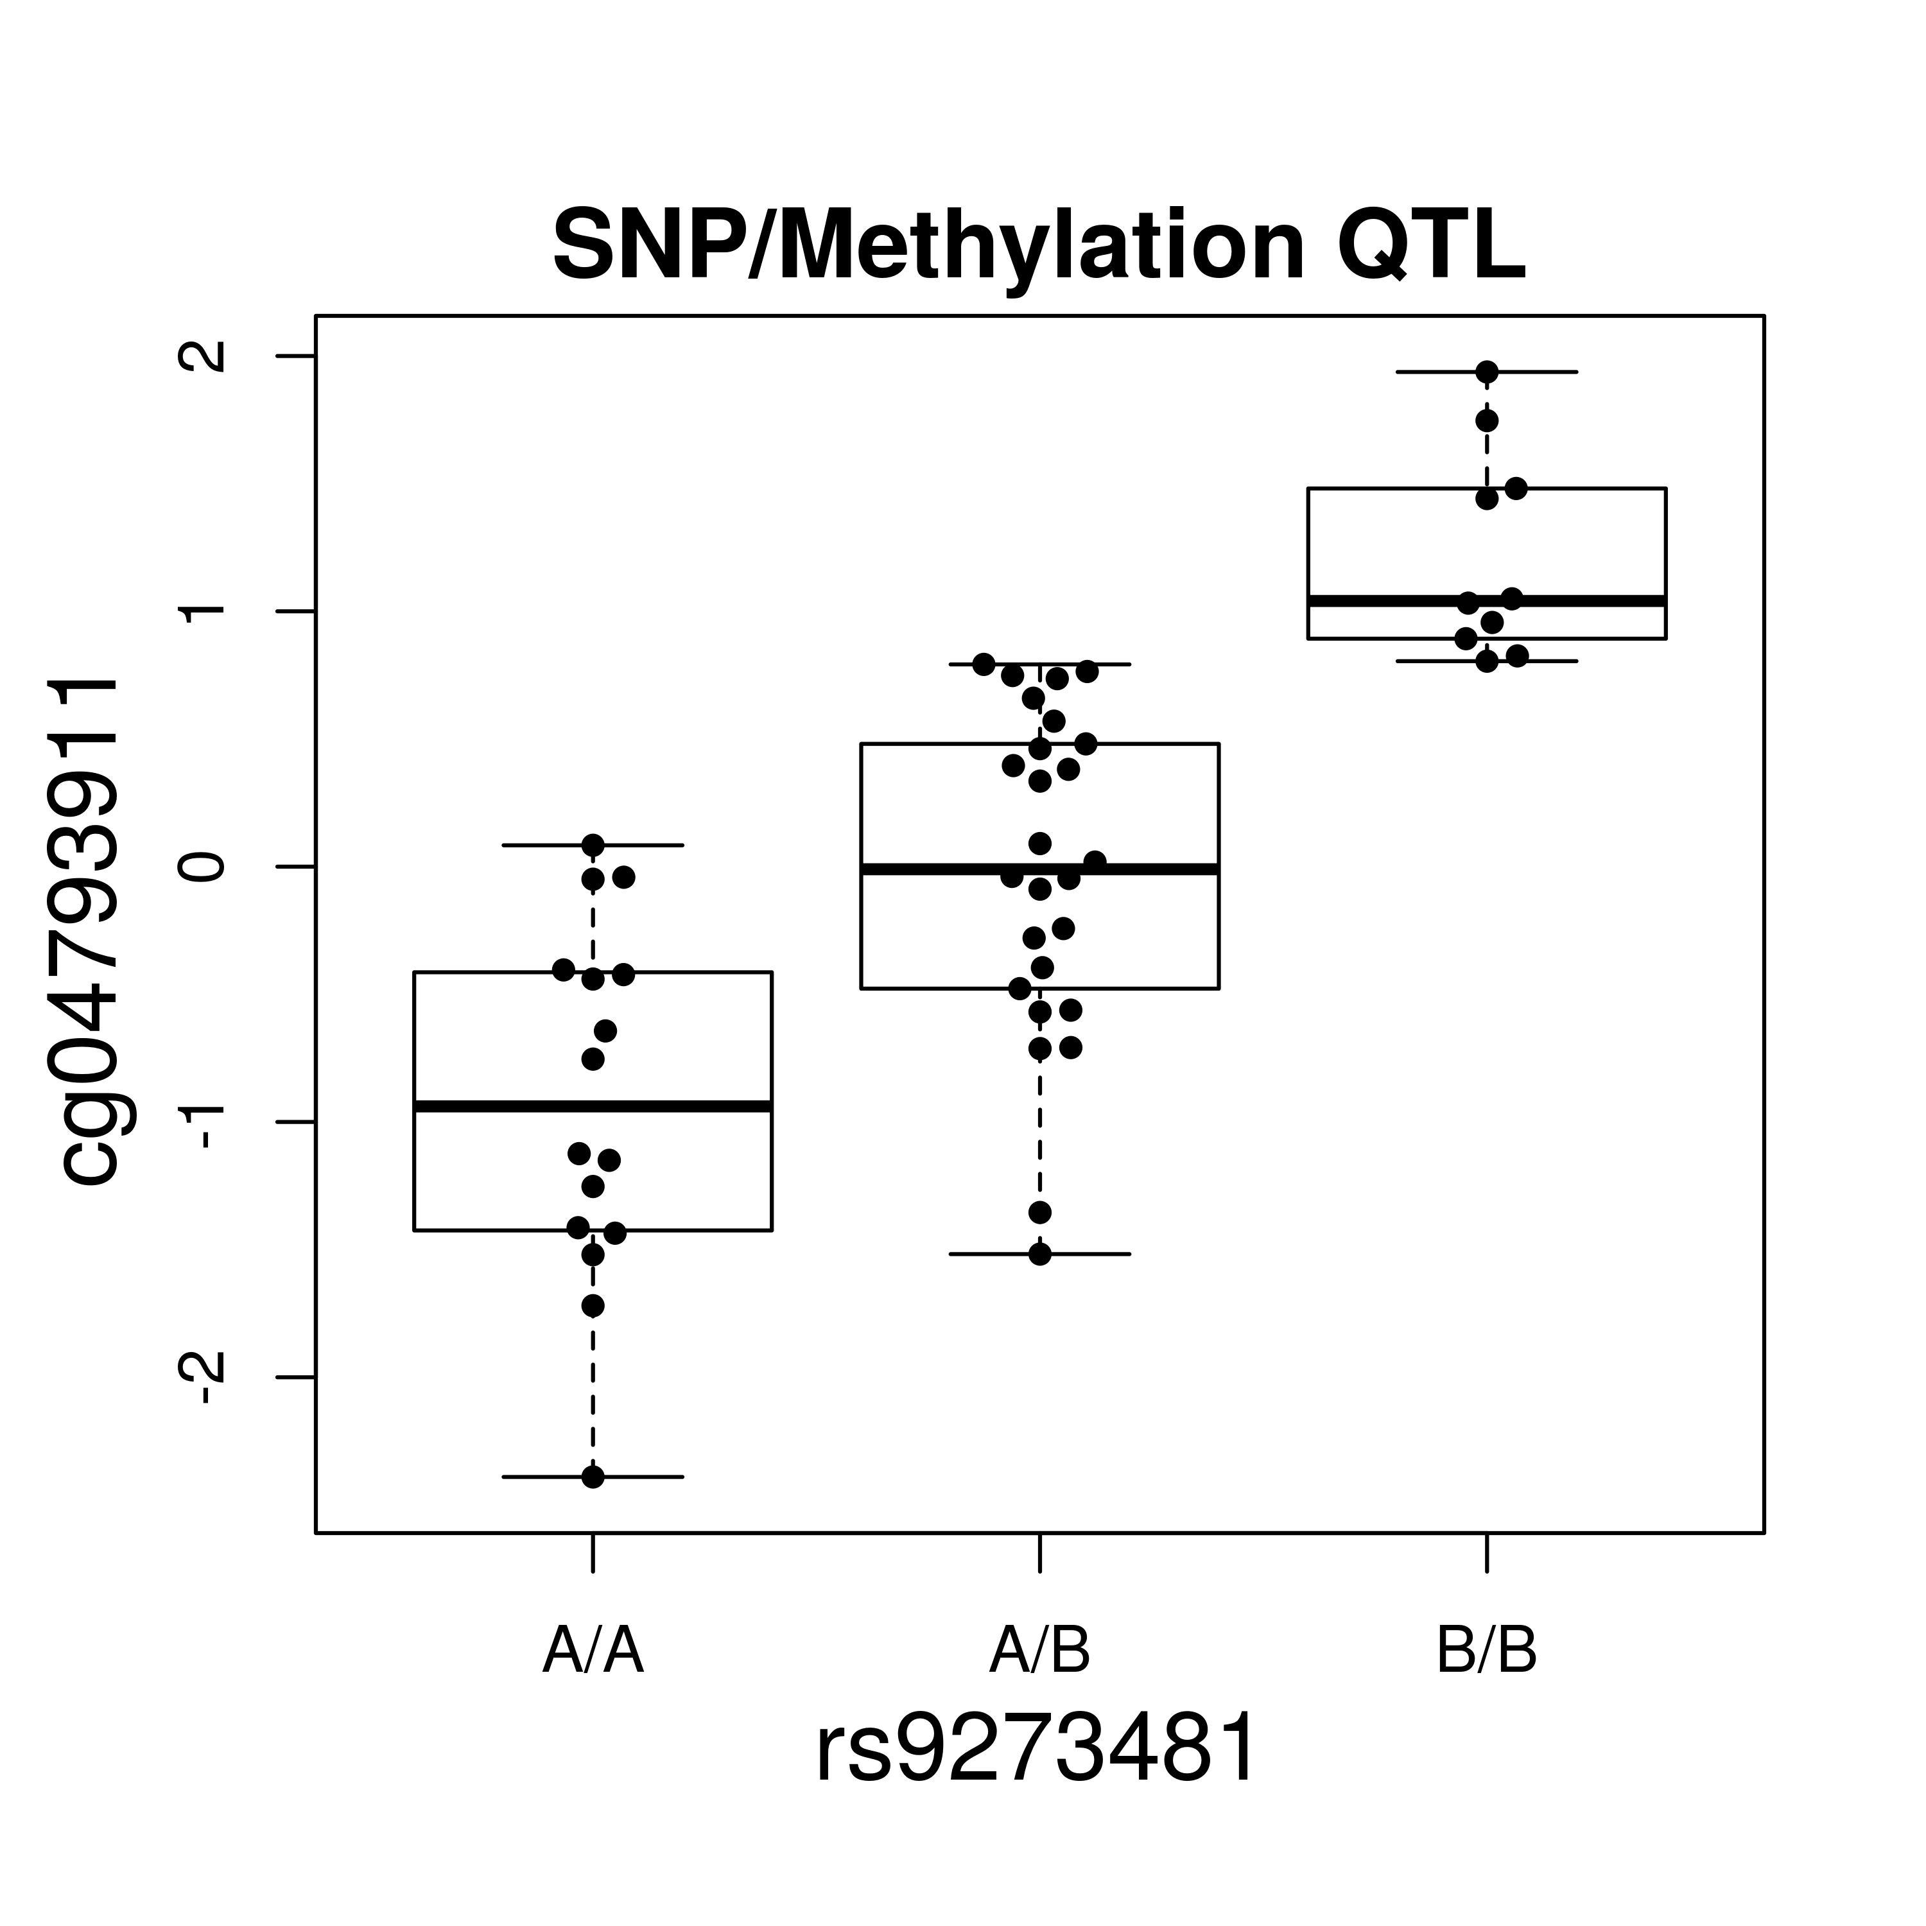
For integrating remotely stored data
Using tabix-indexed SNP VCFs from 1000 genomes
on Amazon S3
credit: Vince Carey
> st <- ldblock::stack1kg() #Create a URL referencing 1000 genomes content in AWS S3
> multiban <- MultiAssayExperiment(
list(meth = banovichSE, snp = st),
colData = colData(banovichSE))
> multibanfocus <- multiban[rowRanges(banovichSE)[“cg04793911”], , ]
> assoc <- cisAssoc(multibanfocus[[“meth”]],
TabixFile(files(multibanfocus[[“snp”]])))
Ramos et al. bioRxiv 144774
Notes:
Larger files, such as SNPs in VCF format, demonstrated here from the 1000 genomes project because this is unrestricted data, can be analyzed for example in this SNP/methylation association study, in chunks from an on-disk representation. This data format, by the way, was supported by default without any modification of MultiAssayExperiment, as is any data class meeting a few minimum requirements.

Slide 13
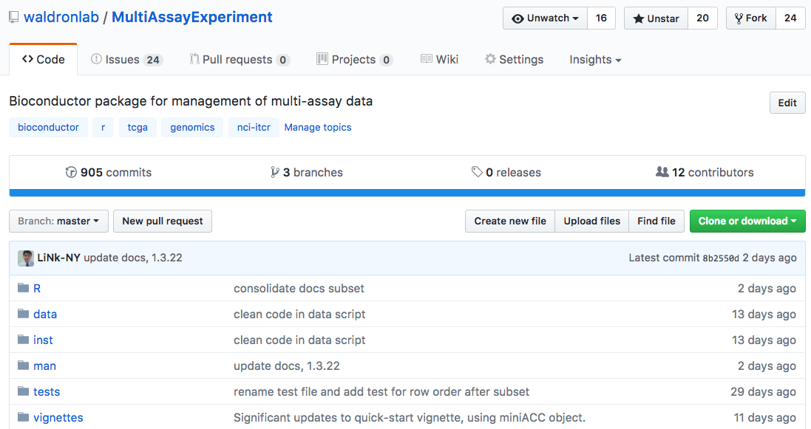
A big software engineering effort

Slide 14
Past curated*Data Bioconductor packages
curatedOvarianData
30 datasets, > 3K unique samples
survival, surgical debulking, histology...
curatedCRCData
34 datasets, ~4K unique samples
many annotated for MSS, gender, stage, age, N, M
curatedBladderData
12 datasets, ~1,200 unique samples
many annotated for stage, grade, OS

Slide 15


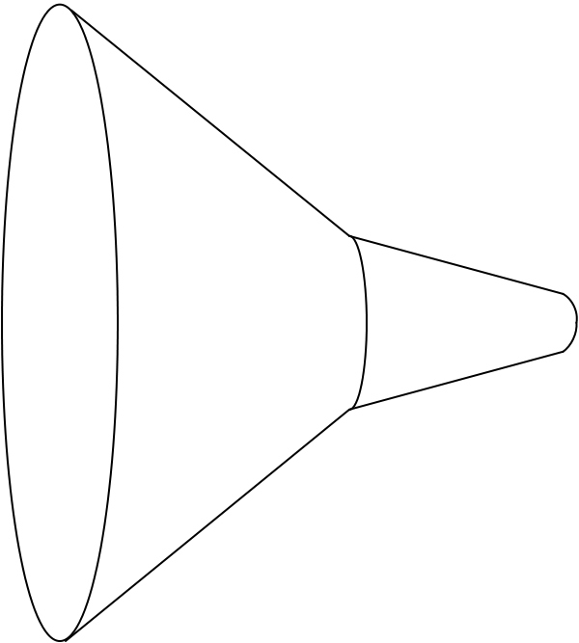

curatedMetagenomicData pipeline
Raw
fastq files
13 datasets
2,875 samples
Study metadata
Age, body site, disease, etc…
Differential abundance
Diversity metrics
Clustering
Machine learning
Convenience download functions
Megabytes-sized datasets
Download (~57TB)
ExperimentHub product
Amazon S3 cloud distribution
Tag-based searching
Dataset snapshot dates
Automatic local caching
Uniform processing
Manual curation
MetaPhlAn2
HUMAnN2
Automatic documentation
species abundance
metabolic pathway abundance
Integrated Bioconductor ExpressionSet objects
Per-patient microbiome data
Per-patient metadata
Experiment-wide metadata
marker
presence
metabolic pathway presence
standardized metadata
marker abundance
gene family abundance
Integration
User
experience
Offline high computational load pipeline
> 120 kH CPU
https://waldronlab.github.io/curatedMetagenomicData/
Notes:
https://upload.wikimedia.org/wikipedia/commons/thumb/7/7e/Funnel_Mech.svg/667px-Funnel_Mech.svg.png
https://pixabay.com/en/cheering-happy-jumping-people-297419/

Slide 16
curatedMetagenomicData use
One dataset from R:
> curatedMetagenomicData("HMP_2012.metaphlan_bugs_list.stool”)
, relab=FALSE)
Many datasets from R:
> curatedMetagenomicData("HMP_2012.metaphlan_bugs_list.*”)
Command-line:
$ curatedMetagenomicData -p "HMP_2012.metaphlan_bugs_list.*"
Pasolli/Schiffer/Manghi et al., bioRxiv 103085

Slide 17
Supervised disease classification
Credit: Edoardo Pasolli
Pasolli/Schiffer/Manghi et al., bioRxiv 103085

Slide 18
Unsupervised clustering
Credit: Audrey Renson
Pasolli/Schiffer/Manghi et al., bioRxiv 103085

Slide 19
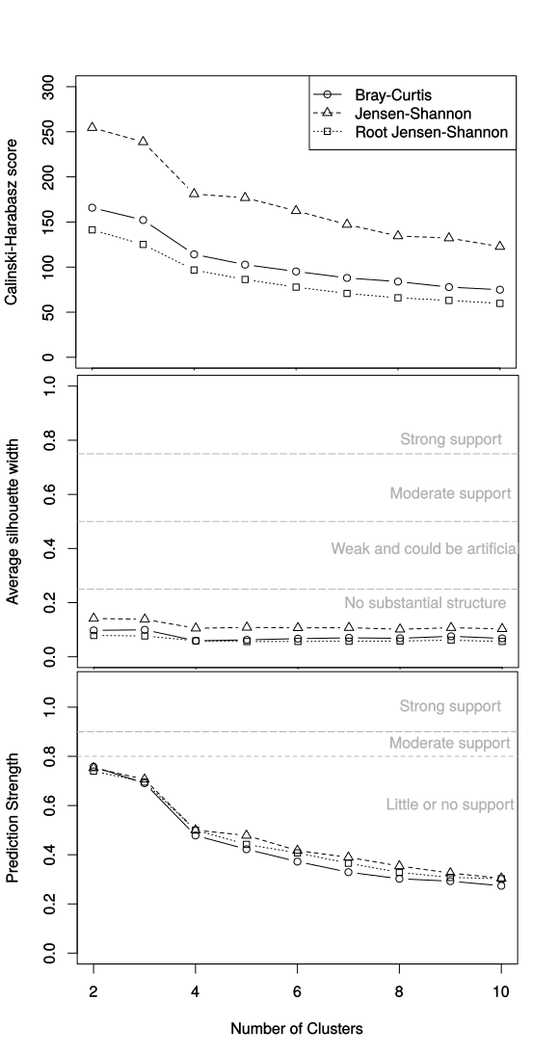
Unsupervised clustering
Credit: Audrey Renson
Pasolli/Schiffer/Manghi et al., bioRxiv 103085

Slide 20
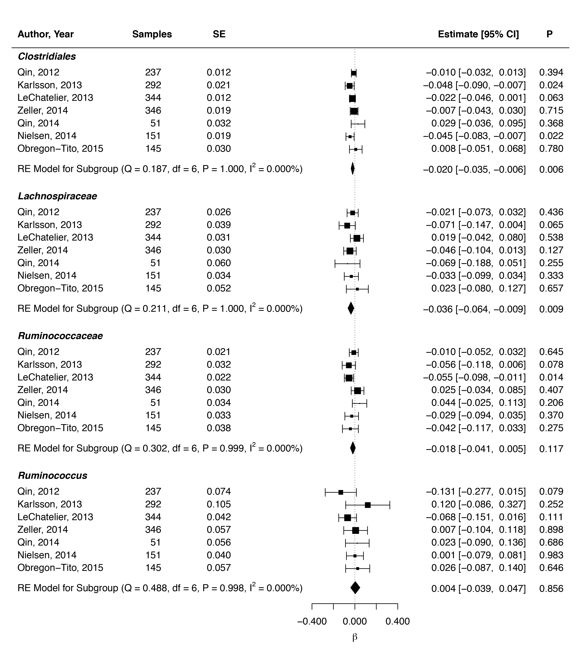



Meta-analysis
(partial) validation of reported associations between genera and BMI
Credit: Lucas Schiffer
Beaumont M et al. Heritable components of the human fecal microbiome are associated with visceral fat. Genome Biol. 2016;17:189.

Slide 21
curatedMetagenomicData summary
25 datasets (5,716 samples) available
Six data products per dataset
Three taxonomy-based from MetaPhlAn2
Three functional from HUMAnN2
Reproduce all analyses in manuscript at:
https://waldronlab.github.io/curatedMetagenomicData/analyses/
Lowest barrier to entry, highest level of curation of any microbiome data resource
Pasolli/Schiffer/Manghi et al., bioRxiv 103085

Slide 22
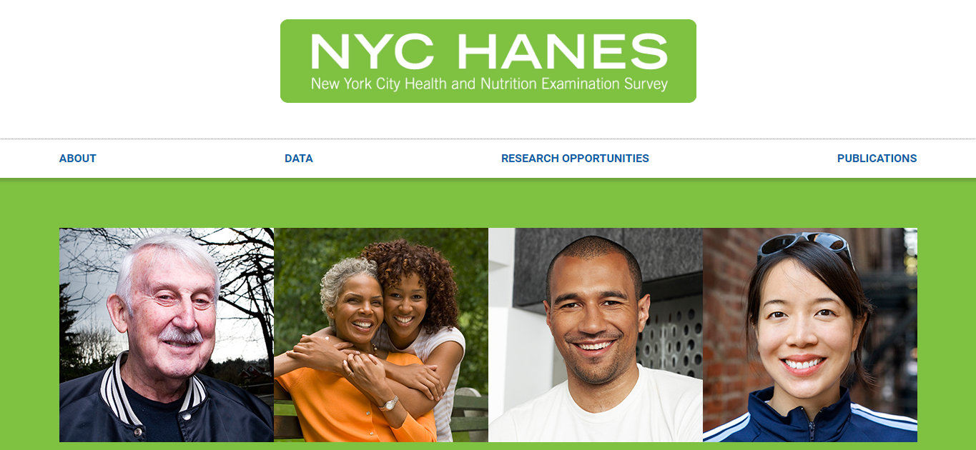

Population-representative sample of non-institutionalized adults in NYC
Conducted by CUNY SPH and the NYC DOHMH
Lorna Thorpe & Sharon Perlman, PIs
Microbiome analysis by my group and Nicola Segata’s lab
Notes:
First of all I want to introduce NYCHANES which is a project started in 2013 and coordinated by two NY institutions, the CUNY School of public Health and the Department of Health and Mental Hygene. Pratically speaking It’s a large-scale survey made to assess the health status of adult new yorkers.

Slide 23
+3500 New Yorkers were asked to answer +800 questions
Questionnaire including:
Demographic information
Oral hygiene and health
Nutrition and physical activity
Sexual behaviour
Drug, tobacco and alcohol use
Laboratory specimens including:
Blood (cotinine and fasting blood glucose)
Mouthwash saliva specimen for microbiome profiling
http://nychanes.org/about/
Notes:
The survery was addressed to more than three thousand randomly selected New Yorkers that were asked to answer more than 800 question about demographic information and their health status and behavior. For some of them, alongside the questionnarire, some biological specimens were collected. The questionnaire and the elaborated results of the questionnaire are publicly available on the HYCHANES website and open to reseachers to analyze it.
Among the multitude of data collected, we focused on the data regarding the tobacco usage: smoking habits can be known from the questionnaire whereas microbiome can be studied from the saliva specimen.

Slide 24
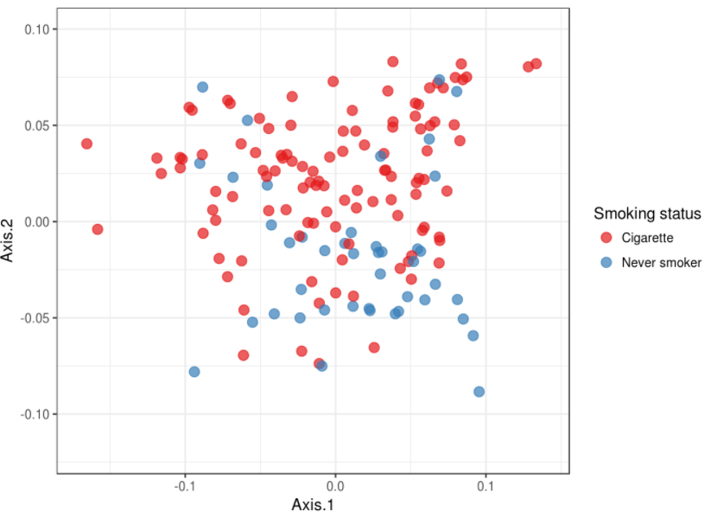
PCoA heavy smokers vs never smokers
Credit: Francesco Beghini

Slide 25
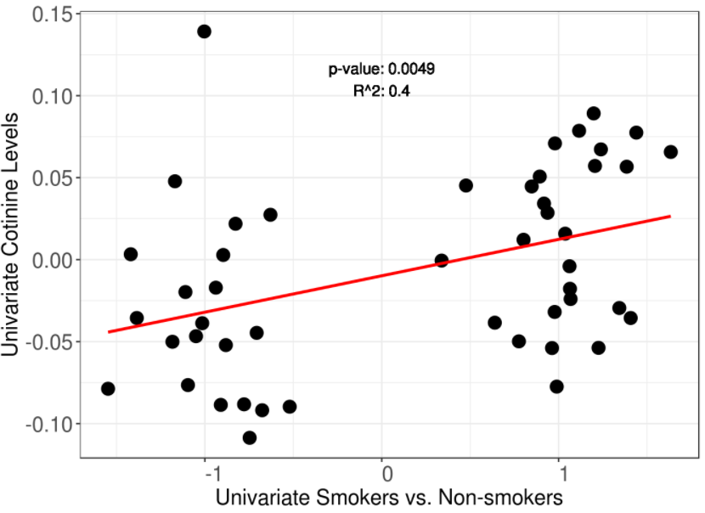
Compare to 2nd hand smoke exposure
Credit: Francesco Beghini

Slide 26
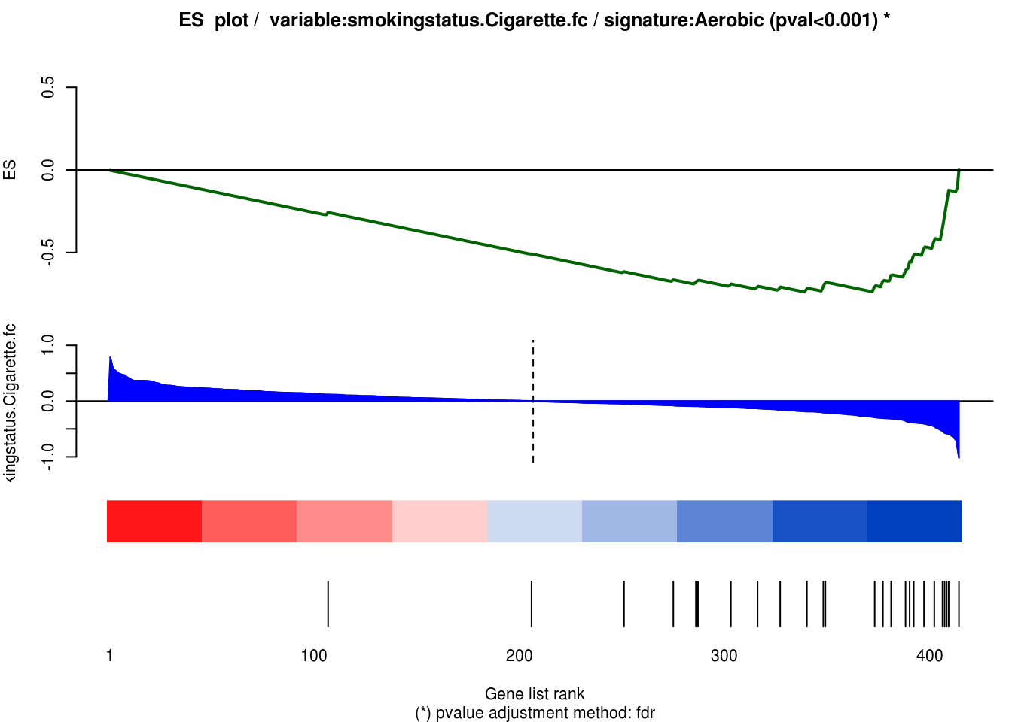
Smokers lose aerobic oral bacteria
Credit: Francesco Beghini

Slide 27
Future work
Wisconsin Longitudinal Study microbiome component
Integrated databases as HDF5, indexed remote files
fast remote slicing of ranges, genes, gene families...
Distribute TCGA, cBioPortal through ExperimentHub
omics and clinical data as MultiAssayExperiments
Curated microbial signatures / BugSigDB

Slide 28
Thank you
Lab (www.waldronlab.org / www.waldronlab.github.io)
Lucas Schiffer (curatedMetagenomicData), Marcel Ramos (MultiAssayExperiment)
Audrey Renson, Andy Samedy, Rimsha Azar, Carmen Rodriguez, Tiffany Chan, Abzal Bacchus, Jaya Amatya, Ludwig Geistlinger
Collaborators
Nicola Segata lab
Francesco Beghini, Edoardo Passoli, Paolo Manghi
Heidi Jones, Jennifer Dowd, Sharon Perlman, Lorna Thorpe, Robert Burk Lab (NYC-HANES)
Valerie Obenchain, Martin Morgan (Bioconductor core team)
CUNY High-performance Computing Center
Statistical Learning Book Club:
Join us remotely
http://tinyurl.com/huw8cb5
Notes:
met Jin Xu from East China Normal University, Shanghai

